Slide 1
Software interrupts
Recommended reading:
Chapter 8 Computer architecture and Assembly language programming by Belal Hashmi.

Slide 2
Display data on screen-EXAMPLE?
MOV AX, 0xB800
MOV ES, AX ; Initializing ES with video memory address
MOV AL, ‘5’; AL=35h
; Printing the character on screen.
XOR DI, DI ; screen location di=0 top left.
MOV AH,07h ; attribute byte
STOSW ; displaying on screen

Slide 3
Calling Interrupt for keyboard input-Example(Key Stroke)
MOV AX, 0xB800
MOV ES, AX ; Initializing ES with video memory address
MOV AH, 0 ; service number
INT 0x16 ; calling interrupt number 16h
; When you call interrupt 16h with service number 0, processor waits for keyboard input. When a key is pressed, its ASCII value is stored in AL register.
; Printing the character on screen.
XOR DI, DI ; screen location di=0 top left.
MOV AH,07h ; attribute byte
STOSW ; displaying on screen

Slide 4
Quit printing upon pressing ESC key
MOV AX, 0xB800
MOV ES, AX ; Initializing ES with video memory address
XOR DI, DI ; screen location di=0 top left.
again:
MOV AH, 0 ; service number
INT 0x16 ; calling interrupt number 16h
; When you call interrupt 16h with service number 0, processor waits for keyboard input. When a key is pressed, its ASCII value is stored in AL register.
MOV AH,07h ; attribute byte
STOSW displaying on screen
; cmp al, 0x1b
jne again

Slide 5
READING INPUT WITH ECHO
[org 0x100]
REPEAT:
CMP AL,13 ; 13 Ascii for enter button
JE EXIT
MOV AH,0
INT 16H ; Interept for keystroke
MOV AH,0X0E ; Attribute byte
INT 10H ; Interept for output
LOOP REPEAT
EXIT:
MOV AX,0X4C00
INT 21H ;Interept to end the program
[org 0x100]
REPEAT:
CMP AL,13
JE EXIT
MOV AH,01
INT 21H
LOOP REPEAT
EXIT:
MOV AX,0X4C00
INT 21H

Slide 6
[org 0x100]
JMP START
MSG: DB 'WELCOME,'
NAME: TIMES 50 DB 0
START:
MOV DI,NAME
REPEAT:
CMP AL,13
JE EXIT
MOV AH,01
INT 21H
STOSB
JMP REPEAT
EXIT:
MOV SI,MSG
AGAIN:
LODSB
CMP AL,13
JE STOP
MOV AH,0X0E
INT 10H
JMP AGAIN
STOP:
MOV AX,0X4C00
INT 21H

Slide 7
[org 0x100]
JMP START
MSG: DB 'WELCOME,'
NAME: TIMES 50 DB '$‘
START:
MOV DI,NAME
REPEAT:
CMP AL,13
JE EXIT
MOV AH,01 ;Service number 1 to operate this interept
INT 21H ; Interept for both input and output
STOSB
JMP REPEAT
EXIT:
MOV DX,MSG
MOV AH,09
INT 21H
MOV AX,0X4C00
INT 21H

Slide 8
Interrupt vector table
8086/8088 processor has 256 interrupts.
Interrupts can be called via instruction INT N; Where, N is the interrupt number. N can be between (0-255).
For each number ‘N’, there exists a program in memory, called interrupt service routine (ISR).
For 256 interrupts, there exist 256 ISR programs in memory.
The addresses (offset & segment) of those programs reside in Interrupt vector table.

Slide 9
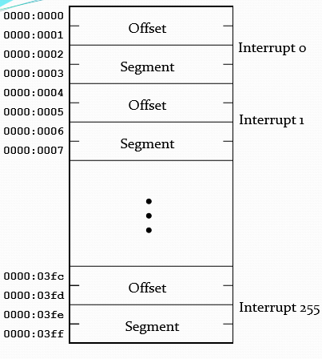
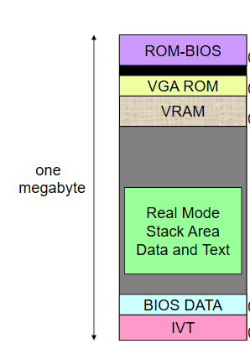
Interrupt vector table

Slide 10
Interrupt vector table-address mapping
Given a vector INT n; n can be any interrupt number.
Where is the ISR address for ‘INT n’ stored in memory?
Offset can be found at: n*4
Segment can be found at: n*4+2
For example, for int 16h ; 16h=22 decimal
Offset will be at: 22*4=88 or 58h
Segment will be at: 22*4+2=90 or 5A

Slide 11
Interrupt zero: INT 0
Interrupt 0 whose address is at location 0 in interrupt vector table automatically executes when a divide overflow occurs.
How does divide overflow occur?
In divide operation, divide overflow occurs when quotient is too large to fit in destination register.
Interrupt service routine whose address is in memory at zero location can be executed via instruction INT 0.
In both cases, a predefined program executes which indicates a divide overflow error.

Slide 12
ISR hooking- divide by zero overflow
Changing address (offset & segment) of INT 0 in interrupt vector table..
We have replaced the address of original ISR with our ISR for divide overflow.
XOR DI, DI;
MOV ES, DI
MOV AX, ISR0;
MOV [ES:0],AX;
MOV [ES:2], CS;
MOV AX, 100
DIV BL
Ret
ISR0:
MOV AX, 0XB800
MOV ES, AX;
MOV WORD [ES:0], 0X0741;
IRET

Slide 13
ISR hooking-divide by zero
jmp start
message db ‘Your message for divide overflow',0;
start:
xor di, di;
mov es, di
mov ax, isr0;
mov [es:di],ax;
mov [es:di+2], cs;
mov ax, 100
div bl
.exit
isr0:
mov ax, 0xb800
mov es, ax;
MOV si, message;
mov ah,7
nextchar:
lodsb;
cmp al, 0
je skip
stosw
jmp nextchar
skip:
iret

Slide 14
Interrupt hooking with int 0x16
XOR DI, DI;
MOV ES, DI
MOV AX, MYISR;
MOV [ES:16H*4],AX;
MOV [ES:16H*4+2], CS;
MOV AH,0;
INT 16H;
MOV AX, 4C00H
INT 21H
MYISR:
MOV AX, 0XB800
MOV ES, AX;
MOV WORD [ES:0], 0X0741;
IRET
Replacing INT 0x16 ISR with your own ISR
In this case, int 0x16 doesn’t prompt for user input?
Why?
Because you have changed the default addresses of int 0x16 in interrupt vector table with your own interrupt service routine.

Slide 15
What happens when an interrupt occurs?
Processor does following operations whenever an interrupt occurs before controls shifts to the defined Interrupt service routine…
Pushes flags ; current flag status.
Disables interrupt flag (IF) and Trap flag (TF).
Pushes segment CS of next instruction; the return address segment
Pushes offset of next instruction; the return address offset
Assign new values to IP and CS by reading addresses from interrupt vector table, such as IP=0: [n*4] CS=0: [n*4+2]

Slide 16
Interrupt service routine termination-iret
ISR is terminated by iret instruction.
Iret instruction pops the parameters which were pushed in interrupt call and restores processor state by doing the following
POP top of stack to IP
POP top of stack to CS
POP top of stack to FLAG Register

